Slide 1
Introduction to Epidemiology and Biostatistics
Class 5: May 19, 2022
Linear Regression

Slide 2
Class Information
Dates: Every week on Thursdays, 6 occurrence(s)
Apr 21, 28
May 5, 12, 19, 26
Time: 5:00 – 6:00 pm
Course Website:
https://tilda.tcd.ie/epidemiology-biostatistics-course/
Zoom Link: https://zoom.us/j/96995332761
Questions: Please use CHAT on your zoom page

Slide 3
Class 5 Lecture Outline
Linear Regression
  a. What it is
  b. How it works
  c. How to interpret it
Confounding
Sophisticated Example

Slide 4
Terminology
Y = Dependent Variable =
Outcome: disease or condition of interest
X = Independent Variable =
Risk Factor: that which may affect the outcome
Predictor: that which predicts an outcome
Exposure: that factor or characteristic which may affect or increase risk of a specific disease or other outcome
Intervention: something done to modify the outcome

Slide 5
Definition: Linear Regression
Attempts to model the relationship between two variables by fitting a linear equation to observed data. One variable is considered to be an explanatory variable, and the other is considered to be a dependent variable. (http://www.stat.yale.edu/Courses/1997-98/101/linreg.htm)
A linear approach for modeling the relationship between a scalar response and one or more explanatory variables (also known as dependent and independent variables). (https://en.wikipedia.org/wiki/Linear_regression)
The relationships are modeled using linear predictor functions whose unknown model parameters are estimated from the data. Such models are called “linear models”.

Slide 6
Linear Regression
The case of one explanatory variable is called simple linear regression
More than one explanatory variable is called multiple linear regression
Often used when an “experiment” is not possible – deals with real variation
Dependent Variable (outcome) is continuous or discrete
Independent variables may be any type (categorical or continuous)

Slide 7
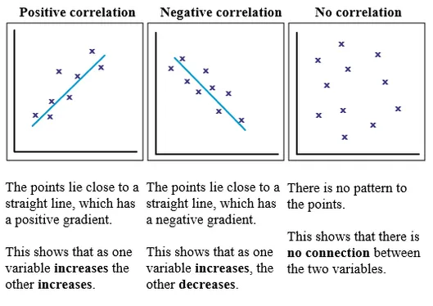
Scatterplots
A scatterplot is a visual representation of the relationship or association between two continuous variables, which are represented as points for each pair of scores.

Slide 8
Correlation Linear Regression
They are related but distinct
Concept: Linear regression fits the “ best line” through a graph of data points
Simple view: It finds the straight line that that comes closest to the points on a graph
Correlation quantifies the degree to which the data are related but does NOT fit a line to the data
Correlation: X and Y are interchangeable
Regression: finds the line that best predicts Y from X
Motulsky H. Intuitive Biostatistics: A nonmathematical guide to statistical thinking. 4th ed. Oxford University Press 2018.

Slide 9
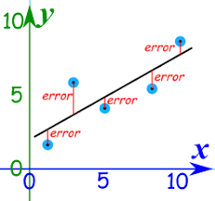
A Line of Best Fit
A regression line is simply a single line that best fits the data (in terms of having the smallest overall distance from the line to the points). Statisticians call this technique for finding the best-fitting line a simple linear regression analysis using the ordinary least squares (OLS) method.
The error here represents how far the predicted values of y (y-hat) differ from the observed values of y

Slide 10
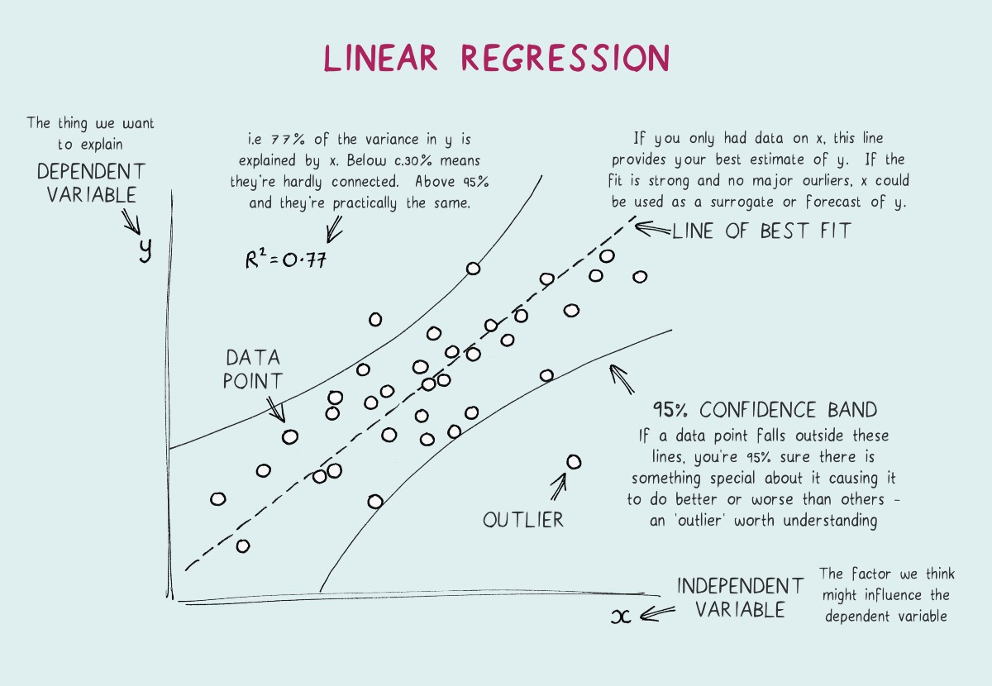
Components of Linear Regression
https://towardsdatascience.com/linear-regression-explained-1b36f97b7572

Slide 11
Components of Simple Linear Regression
This is a primer so you do not need to worry about the mathematics and statistical assumptions of what we are trying to do BUT it is important to understand conceptually what we are trying to do.
Y_{i} = B₀ + B₁X_{i} + E_{i}
By determining the values of B₀ and B₁ we can calculate the predicted value of “Y” for any given value of “X”.
Slope coefficient
Outcome
Error term
Intercept or the constant
Predictor variable

Slide 12
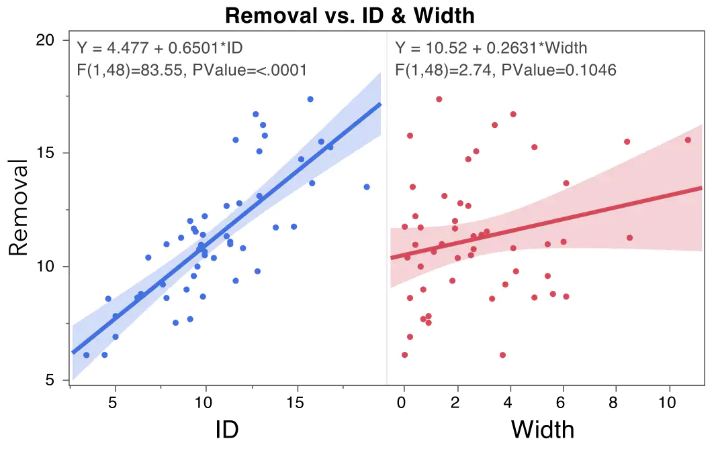
https://www.jmp.com/en_au/statistics-knowledge-portal/what-is-multiple-regression.html

Slide 13
Multiple Linear Regression
Two or more independent (explanatory predictor) variables
Fitting the line in an “x-dimension” space
Minimizes difference between data points and regression line
Equation: Y_{i} = B₀ + B₁X₁ + B₂X₂ + B_{j}X_{j} + E_{i}
nt
outcome intercept slope-coefficient predictor error

Slide 14
How to Interpret Regression Parameters
Coefficient = Effect Size
  signifies how much the mean of the dependent variable (Y) changes given a one-unit shift in the independent variable (X) while holding other variables in the model constant
  sign = positive or negative association
SE of the Coefficient: Standard Deviation of error term
Standardized Coefficient: unitless, allowing comparisons between studies and variables that use different units
t: statistic used to calculate significance
p-values = significance = tests the null hypothesis that the independent variable (Y) has no association with the dependent variable (X).
R²= proportion of the variance for a dependent variable

Slide 15
R-squared
R² = proportion of the variance for a dependent variable that's explained by an independent variable in a regression model
Explains to what extent the variance of one variable explains the variance of the second variable
If R² of a model is 0.50, then approximately half of the observed variation can be explained by the model's inputs.
Interpretation of a “good” R² depends on context. In medical research, even a small value can be meaningful.

Slide 16
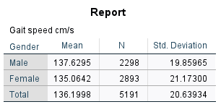
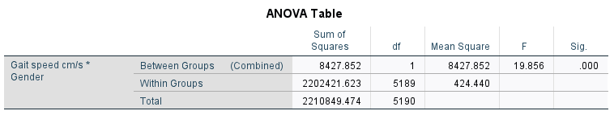
Example: Gender and Gait Speed
Comparison of Means

Slide 17
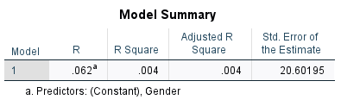
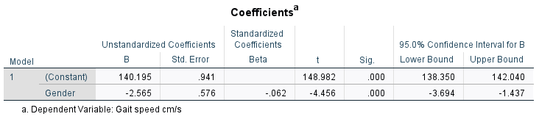
Example: Gender and Gait Speed
Simple Linear Regression
Note direction of the coefficient for gender

Slide 18
Multiple Linear Regression
Two or more independent (explanatory predictor) variables
Fitting the line in an “x-dimension” space
Minimizes difference between data points and regression line
Equation: Y_{i} = B₀ + B₁X₁ + B₂X₂ + B_{j}X_{j} + E_{i}
nt
outcome intercept slope-coefficient predictor error

Slide 19
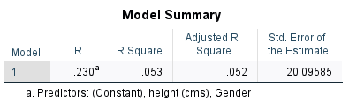
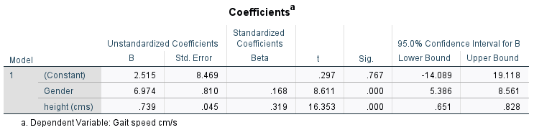
Example: Gender and Gait Speed
Multiple Linear Regression (2 indep vars)
Note direction of the coefficient for gender

Slide 20
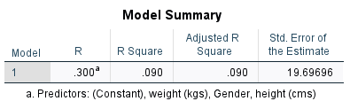
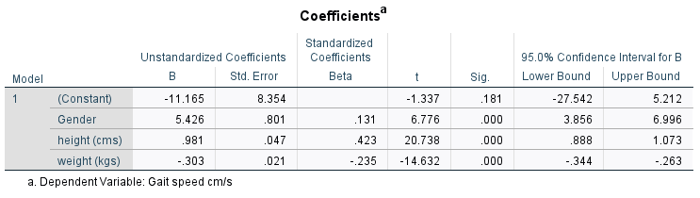
Example: Gender and Gait Speed
Multiple Linear Regression (3 indep vars)

Slide 21
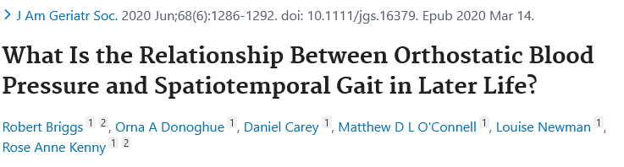

Slide 22
Briggs, et al. JAGS 2020

Slide 23
Briggs, et al. JAGS 2020

Slide 24
LINEAR REGRESSION MODEL
Briggs, et al. JAGS 2020

Slide 25
LINEAR REGRESSION MODEL
Briggs, et al. JAGS 2020

Slide 26
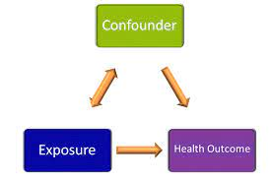
Confounding
Occurs when a third factor is a real cause of the outcome and the predictor of interest is associated with, but not a cause of, this third factor
In order to be a confounder, a variable must be associated with the predictor of interest and also the outcome
Distorts the true association between exposure and outcome

Slide 27
Examples of Confounding
Grass growth and flowers blooming are positively correlated, but both are likely caused by a third variable (amount of sunshine)
Sales of ice cream and shark attacks are positively correlated, but both likely due to a third variable (warm weather).
Women walk slower then men. However, women tend to be shorter and weigh less than men. If you CONTROL (adjust) for height and weight, (where increased height and decreased weight are associated with walking faster), then women actually walk faster than men.

Slide 28
Coping with Confounders
At the Design Stage
  Specification
  Matching
  Opportunistic Studies
At the Analytic Phase
  Stratification (Effect Modification)
  Statistical Adjustment
  Propensity Scores

Slide 29
Coping with Confounding: Design Stage
  Specification: restrict inclusion criteria to one level of the confounder (e.g. non-smokers if you believe smoking is a confounder)
  Matching: for case-control studies, select cases and controls with matching values of the confounding variables (preserves generalizability as all levels of confounders can be include)
  Opportunistic Studies: situation where confounders can be controlled without manipulation
      Case-crossover studies
      Natural experiments ex. Nursing home outcomes admitted during the
      week vs weekend
      Mendelian Randomization utilize the gene for a trait rather than a trait
      that can be self-selected, e.g.use polymorphism for susceptibility used for exposed/unexposed status

Slide 30
Coping with Confounding: Analytic Stage
    Stratification (Effect Modification):
      stratify analyses on levels of the confounder
      compares results of same status, e.g. smokers vs non-smokers
      check for interactions
  Statistical Adjustment can control confounders simultaneously
    Propensity Scores:
      create a multivariate model to predict a score of all potential
      confounders
      Subjects can be assigned a predicted probability for the
      exposure (e.g. treatment)
      Match on the propensity score

Slide 31
EXAMPLE 9.1 Propensity Analysis
Gum et al. prospectively studied 6,174 consecutive adults undergoing stress echocardiography, 2,310 of whom (37%) were taking aspirin and 276 of whom died in the 3.1-year follow-up period. In unadjusted analyses, aspirin use was not associated with mortality (4.5% in both groups). However, when 1,351 patients who had received aspirin were matched to 1,351 patients with the same propensity to receive aspirin but who did not, mortality was 47% lower in those treated (P = 0.002).
Gum PA, Thamilarasan M, Watanabe J, et al. Aspirin use and all-cause mortality among patients being evaluated for known or suspected coronary artery disease: A propensity analysis. JAMA 2001;286(10):1187–1194

Slide 32
Abstract
Objectives: A high resting heart rate (RHR) represents a major risk factor for cardiovascular disease and individuals from poorer backgrounds have a higher RHR compared with their more advantaged peers. This study investigates the pathways through which low socioeconomic status (SES) contributes to a higher RHR.
Method: The sample involved data for 4,888 respondents who were participating in the first wave of The Irish Longitudinal Study on Ageing. Respondents completed a detailed interview at home and underwent a 5-min baseline electrocardiograph recording as part of a clinic-based health assessment. SES was indexed using household income.

Slide 33
BACKGROUND
Figure 1: Life Expectancy at Time of Birth by Area of Deprivation (Quintile)
Source: Mortality Differentials in Ireland, Central Statistics Office (2010)
Notes:
This graph shows average life expectancy in Ireland at time of birth for men and women by whether you lived in an advantaged or a deprived area.
1. If you look at the left hand side of the chart you can see that women who live in the least deprived areas have a life expectancy that is 2.7 years higher on average compared with women in the most deprived areas.
2. The differential is even greater for men. Men in the least deprived quintile will live 4.3 years longer on average compared with men in the most deprived quintile.
This is what we mean when we talk about the social gradient in health. Gradients can be found across practically every health outcome we look at but are particularly pronounced for CVD.

Slide 34

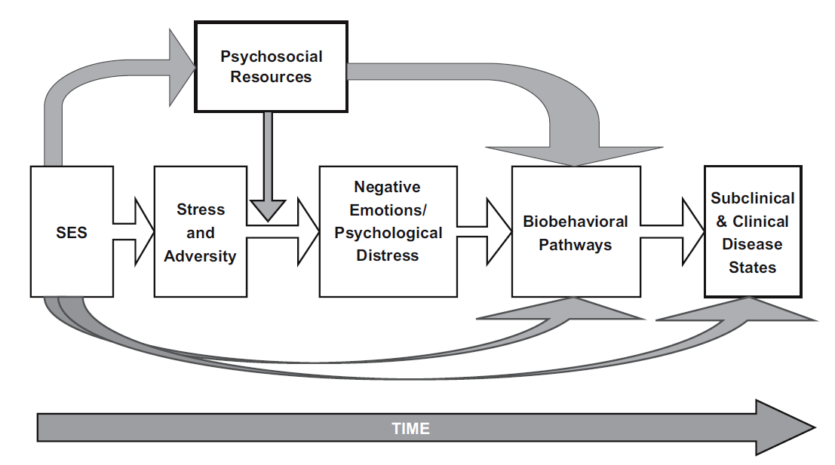
Figure 3: Pathways from SES to health
Source: Matthews & Gallo (2011). Psychological perspectives on pathways linking socioeconomic status and physical health. Annual Review of Psychology, 62, 501-530.
Notes:
Psychologists accept that differences in lifestyle are important but we also believe that perceptions, cognitions and emotions are important too.
This model hypotheses predisposes to more stressors while simultaneously constraining the amount of psychosocial resources one has to overcome these stresses.
1. Over time, these stressors and the negative emotional states that they elicit lead to chronic activation of the stress response and we know that stress can damage the heart.

Slide 35
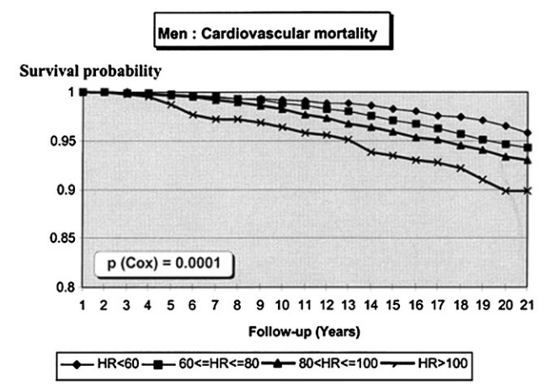
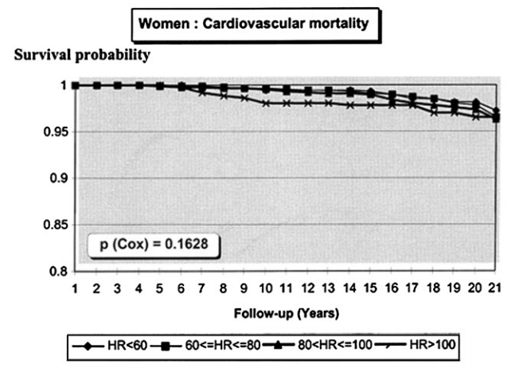
Figure 4: Heart Rate and Cardiovascular Mortality
Source: Giannoglou et al, (2008): International Journal of Cardiology, 3(6) 302-312
Notes:
It is well established that a high resting heart rate is a risk factor for cardiovascular mortality. This graph shows the relationship between heart rate and cardiovascular mortality over a 21 year follow up period.
1. Heart rate is broken up into 4 groups. The vertical axis shows the proportion of people still alive at follow-up. One can see that people with a higher resting heart rate die earlier compared with their peers.

Slide 36
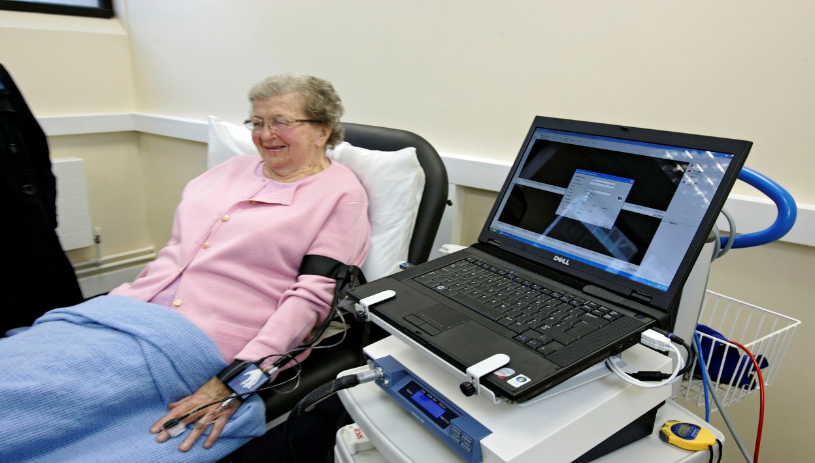
Methods
Resting Heart Rate
  surface electrocardiogram recording
SES : personal interview (quintiles)
  Lowest (<€14,000)
  2nd (€14,000 – <€24,000)
  3rd (€24,000 - <€30,000)
  4th (€30,000 - <€55,000)
  Highest (€55,000+ )
Social Network Score (0-4)
  Married
  2 or more friends
  Church group/clubs
  Volunteering
Loneliness Scale
    5 questions
    scale of often/some of the time/hardly ever-never

Slide 39
Adjustments
Model 1: age, sex, # in HH, SBP, DBP, HTN Meds,
Model 2: model 1 + diabetes, hazardous drinking, smoking, PA, lipids, waist, height
Model 3: model 1 + social network score, perceived stress, loneliness scale
Note: model 4 = all variables in the model (model 2 and model 3)

Slide 40
Abstract
Discussion: The finding that poorer people have a higher RHR reinforces the need for additional research exploring the pathways through which social inequalities are translated into biological inequalities.

Slide 41
Acknowledgements
Dr. Cathal McCrory (Content)
Prof. Rose Anne Kenny (Assistance)
TILDA Authors (Publications)
QUESTIONS?
THANK YOU!

